Slide 1
A Well Mind Mental Health and you a veteran
Ken Mattingly
Post 6582
Scottsburg, Indiana

Slide 2
Who is this guy?
Afghanistan 2002-2003, SOT-A, 20th SFG(A)
Iraq 2005-2006, IN Squad Leader, 1-184th IN BN
Iraq 2008-2009, IN Platoon Sergeant, 1-184th IN BN
Guantanamo Bay Cuba 2014-2015, JTF Ops SGM
Warrior Transition Battalion FT Knox 2015-2016, CSM
Ireland Army Hospital FT Knox 2016, CSM
Combat Action Badge 2002
Combat Infantry Badge 2005

Slide 3
Who is this guy?
B.A. Psychology with a concentration in Mental Health
Currently working towards Master’s in CMHC/LMHC
Centerstone: Family Support Specialist / Therapist

Slide 4
Introduction
According to research conducted by the RAND institute, over 2.8 million service members have deployed.
After deployment-
48% experience strains in family life
47% feel sudden outbursts of anger
44% have difficulty adjusting to civilian life
5-39% have issues with alcohol dependence
19-23% have a traumatic brain injury
13-20% experience post-traumatic stress disorder
10-15% experience depression
Notes:
Veterans’ mental health issues. RAND Corporation. (n.d.). https://www.rand.org/health-care/projects/navigating-mental-health-care-for-veterans/mental-health-issues.html

Slide 5
Progression of Mental health
WW2
Korean
Vietnam
Grenada
Panama
Gulf War
Afghanistan
Iraq
Notes:
WW2- We all remember the scene from the movie “Patton,” where Gen. Patton is visiting an aid station and there is a private suffering from shell shock. Gen Patton slaps him across the face and tells him to get out. Berates him about being in the same room with actual wounded soldiers.
As we progress throughout history our medical abilities makes astonishing leaps and bounds.
Since the start of World War II, the researchers found significant gains across two of their measures. The combat fatality rate fell from 55 to 12 percent between the start of World War II and the most recent conflicts, as did the KIA rate (52 to 5 percent). These were all numbers that confirmed historic studies looking at the big picture.
Our treatment and understanding of mental health did not. It has crawled on its belly.
It wasn’t until the Afghanistan War and the Iraqi War that we started to see a shift in mental health treatment.
Units like the Warrior Transition Unit are created.
Private organizations like the Wounded Warrior Project and Tunnels to Towers are formed.

Slide 6
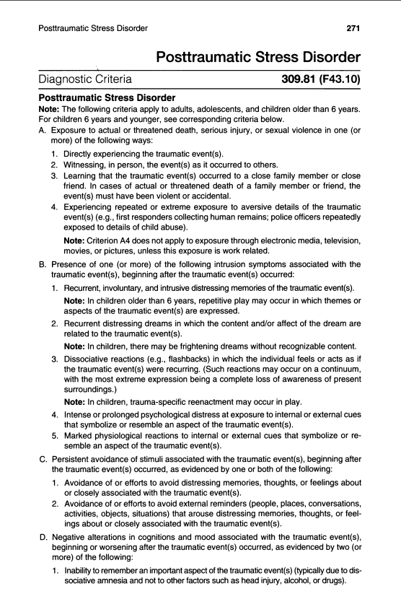
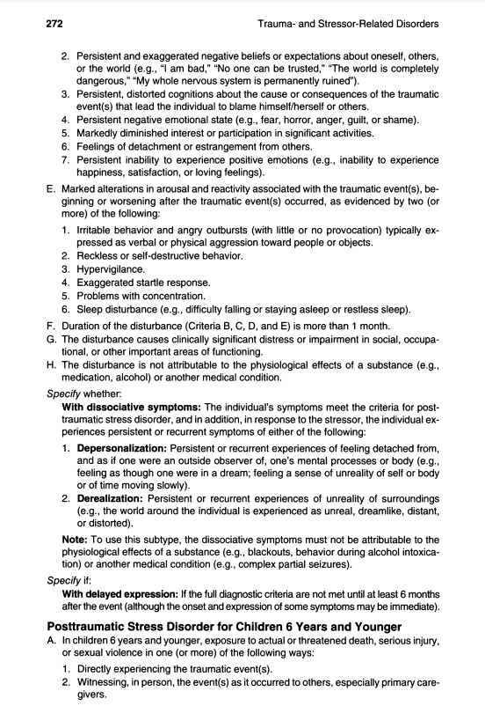
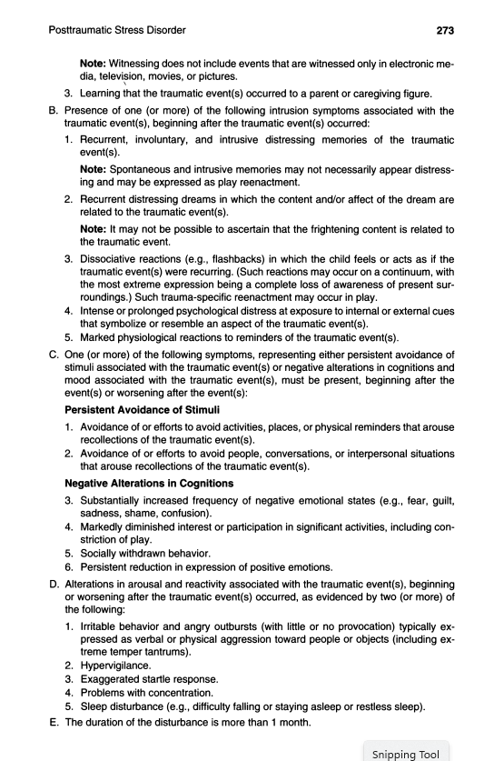
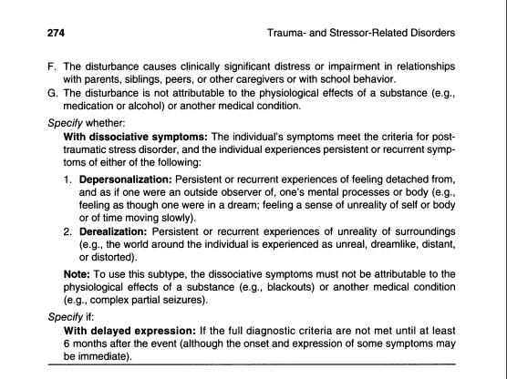
What is PTSD?
Clinical Diagnosis
Notes:
Co-Occurrence – Major Depressive Disorder, Substance abuse, Personality Disorder, Anxiety Disorder and Obsessive-Compulsive Disorder.
Comorbidity Individuals with PTSD are 80% more likely than those without PTSD to have symptoms that meet diagnostic criteria for at least one other mental disorder (e.g., depressive, bipolar, anxiety, or substance use disorders). Comorbid substance use disorder and conduct disorder are more common among males than among females. Among U.S. military personnel and combat veterans who have been deployed to recent wars in Afghanistan and Iraq, co-occurrence of PTSD and mild TBI is 48%. Although most young children with PTSD also have at least one other diagnosis, the patterns of comorbidity are different than in adults, with oppositional defiant disorder and separation anxiety disorder predominating. Finally, there is considerable comorbidity between PTSD and major neurocognitive disorder and some overlapping symptoms between these disorders.

Slide 7
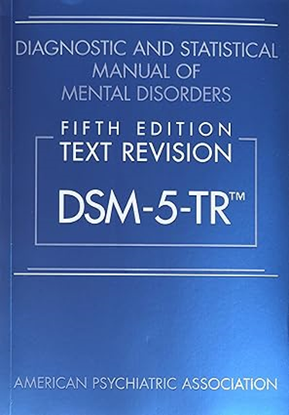
Comorbidity
Individuals with PTSD are 80% more likely to have at least one other mental disorder (e.g., depressive, bipolar, anxiety, or substance use disorders).
Comorbid substance use disorder and conduct disorder are more common among males than among females.
Among U.S. military personnel and combat veterans who have been deployed to recent wars in Afghanistan and Iraq, co-occurrence of PTSD and mild TBI is 48%.

Slide 8
Veteran suicide
According to the VA, 16.8 veterans commit suicide a day (2020).
Veteran suicide is 57.3% greater than for non-veterans U. S. adults.
According to Mission Roll Call, “America’s Warrior Partnership (AWP) recently released a striking report concluding that the veteran suicide rate is 2.4 times greater than the Department of Veteran Affairs (VA).
The AWP findings show 22-24 veterans ages 18-64 commit suicide each day.
Another 18-20 veterans in the same age group die per day by self-injury.
Combined, this points to at least 44 veterans dying daily.
Notes:
Mission Roll Call. (2023, March 29). The State of Veteran Suicide (2022). Mission Roll Call. https://www.missionrollcall.org/post/state-of-veteran-suicide
2022 National Veterans Suicide Prevention Annual Report

Slide 9
Notes:
The interpersonal-psychological theory of suicidal behavior (Joiner, 2005) proposes that an individual will not die by suicide unless he/she has both the desire to die by suicide as well as the ability to do so. What is the desire for suicide, and what are its component parts? What is the ability to die by suicide, and in whom and how does it develop? In answer to the first question of who desires suicide, the theory asserts that when people hold two specific psychological states in their minds simultaneously, and when they do so for long enough, they develop the desire for death. The two psychological states are perceived burdensomeness and a sense of low belongingness or social alienation. In answer to the second question regarding the capability for suicide, self-preservation is a powerful enough instinct that few can overcome it by force of will. The few who can have developed a fearlessness of pain, injury, and death, which, according to the theory, they acquire through a process of repeatedly experiencing painful and otherwise provocative events, often through previous self-injury, but also through other experiences (e.g., repeated accidental injuries; numerous physical fights; occupations like physician and front-line soldier in which exposure to pain and injury, either directly or vicariously, is common).

Slide 10
Veteran suicide in perspective
In 5 days, we lose a Company-size element (200).
In 25 days, we lose a Battalion-size element (1000).
In a little more than 4 months, we lose a Brigade size element (5000).
If we lost any one of these elements in battle, it would be on the news 24/7.
By the time this presentation is over, we will have lost close to 2 of our brothers and sisters to suicide or self-harm.
Why is this not a problem we talk about?
Notes:
173rd Airborne Brigade Combat Team "Sky Soldiers" at Vicenza, Italy - GONE
63rd Theater Aviation Brigade (ARNG) "Wings of Thunder" at Frankfort, Kentucky - GONE
76th Infantry Brigade Combat Team (IBCT) (IN ARNG) - GONE
We talk about jobs, the weather, gas prices, and interest rates, but we don’t discuss mental health.
We need to be proactive when it comes to mental health.
We don’t know what we don’t know.
The key to fighting this problem is educating veterans about available resources.
The number one reason many veterans won't seek mental health is that they are worried about losing their guns.
Out of those 40-plus veterans we are about to lose at the time of their mental crisis, where does possession of guns rank?
I am not here to debate constitutional law. I am not here to argue the 2nd amendment. I have guns.
There is a difference between volunteer treatment, as opposed to losing it, and being placed on a 72-hour hold.
My volunteer treatment is in my medical record and protected by HIPPA and a few other Federal Laws.
Police arrests are public records.

Slide 11
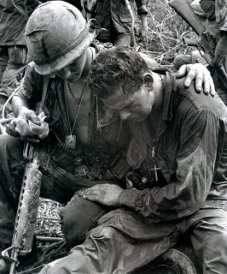
Stigma
Notes:
Broken
The weak link
As an Infantry 1SG, I had a different view of mental health. I had a mission. The infantry’s mission is to close with the enemy by means of fire and maneuver to defeat or capture him, or to repel his assault by fire, close combat, and counterattack.
“The psychiatrists Roy Swank and Walter Marchand found that 98 percent of soldiers who endured 60 days of continuous combat suffered psychiatric symptoms, either temporary or permanent. The two out of 100 soldiers who seemed unscathed by prolonged combat displayed "aggressive psychopathic personalities," the psychiatrist reported ( J. Horgan 2010).

Slide 12
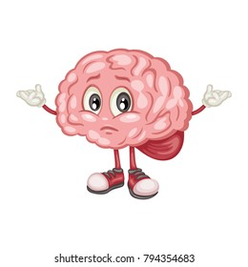
Body and Mind
It’s hard to be mentally healthy when you are always hurting or sick.
It’s hard to be physically healthy when you are mentally unwell.

Slide 13
A simple truth well known in Mental Health research and practice – the mind and body are a single indivisible unit! We are neither a disembodied brain, nor a body without a brain!

Slide 14
Top 5 reasons service members or veterans don’t seek mental health services
45% The medication that might help have too many side effects
44% It could harm my career
44% I could be denied a security clearance
39% My family or friends would be more helpful than a mental health professional
38% My coworkers would have less confidence in me if they found out
Notes:
Tanielian, T., Jaycox, L. H., Schell, T. L., Marshall, G. N., Burnam, M. A., Eibner, C., Karney, B., Meredith, L. S., Ringel, J. S., & Vaiana, M. E. (2008, April 8). Invisible wounds: Mental health and cognitive care needs of America’s returning veterans. RAND Corporation. https://www.rand.org/pubs/research_briefs/RB9336.html
What is the number one reason why many veterans won’t seek mental health? They are worried about losing their guns.
Top medications of 2020
Sertraline (Zoloft): Depression (38.22 million prescriptions)
Escitalopram (Lexapro): Depression and anxiety (30.6 million prescriptions)
Bupropion (Wellbutrin): Depression (28.9 million prescriptions)
Amphetamine/dextroamphetamine (Adderall): ADHD (26.24 million)
Trazodone: Depression (26.21 million prescriptions)
Fluoxetine (Prozac): Panic disorder and depression (23.4 million prescriptions)
Duloxetine (Cymbalta): Depression and anxiety (22.5 million prescriptions)
Citalopram (Celexa): Depression (18.55 million prescriptions)
Alprazolam (Xanax): Anxiety and panic disorder (16.78 million prescriptions)
Methylphenidate (Concerta): ADHD (15.45 million prescriptions)
Venlafaxine (Effexor): Depression and anxiety (15.02 million prescriptions)
Clonazepam (Klonopin): Panic disorder (14.76 million prescriptions)
Buspirone (Buspar): Anxiety (14.75 million prescriptions)
Lamotrigine (Lamictal): Bipolar disorder (10.8 million prescriptions)
Quetiapine (Seroquel): Bipolar disorder and schizophrenia (10.6 million prescriptions)
Lorazepam (Ativan): Anxiety (10.56 million prescriptions)
Clonidine (Kapvay): ADHD (9.87 million prescriptions)
Amitriptyline (Elavil): Depression (9.09 million prescriptions)
Paroxetine (Paxil): Depression, OCD, and panic disorder (9.03 million prescriptions)
Lisdexamfetamine (Vyvanse): ADHD and binge eating disorder (8.64 million prescriptions)

Slide 15
Top medications of 2020 Sertraline (Zoloft): Depression (38.22 million prescriptions) Escitalopram (Lexapro): Depression and anxiety (30.6 million prescriptions) Bupropion (Wellbutrin): Depression (28.9 million prescriptions) Amphetamine/dextroamphetamine (Adderall): ADHD (26.24 million) Trazodone: Depression (26.21 million prescriptions) Fluoxetine (Prozac): Panic disorder and depression (23.4 million prescriptions) Duloxetine (Cymbalta): Depression and anxiety (22.5 million prescriptions) Citalopram (Celexa): Depression (18.55 million prescriptions) Alprazolam (Xanax): Anxiety and panic disorder (16.78 million prescriptions) Methylphenidate (Concerta): ADHD (15.45 million prescriptions)
Notes:
These are single prescriptions. They are not the total amount of pills produced. 1x30

Slide 16
Venlafaxine (Effexor): Depression and anxiety (15.02 million prescriptions) Clonazepam (Klonopin): Panic disorder (14.76 million prescriptions) Buspirone (Buspar): Anxiety (14.75 million prescriptions) Lamotrigine (Lamictal): Bipolar disorder (10.8 million prescriptions) Quetiapine (Seroquel): Bipolar disorder and schizophrenia (10.6 million prescriptions) Lorazepam (Ativan): Anxiety (10.56 million prescriptions) Clonidine (Kapvay): ADHD (9.87 million prescriptions) Amitriptyline (Elavil): Depression (9.09 million prescriptions) Paroxetine (Paxil): Depression, OCD, and panic disorder (9.03 million prescriptions) Lisdexamfetamine (Vyvanse): ADHD and binge eating disorder (8.64 million prescriptions)
Top medications of 2020 cont

Slide 17
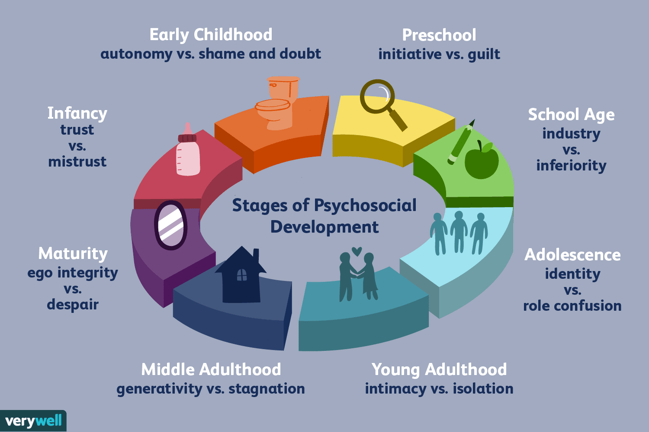
The developmental process
Erikson’s 7 Stages of Life
Stress and the brain
The brains development
Notes:
7 stages of development. 19-29 year olds are in the 6th stage of development. This stage is called intimacy vs Isolation.
Cortisol’s functions are part of the natural process of the body. In moderation, the hormone is perfectly normal and healthy. Its functions are multiple. In addition to restoring balance to the body after a stress event, cortisol helps regulate blood sugar levels in cells and has utilitarian value in the hippocampus, where memories are stored and processed.
But when chronic stress is experienced, the body makes more cortisol than it has a chance to release. This is when cortisol and stress can lead to trouble. High levels of cortisol can wear down the brain’s ability to function properly. According to several studies, chronic stress impairs brain function in multiple ways. It can disrupt synapse regulation, resulting in the loss of sociability and the avoidance of interactions with others. Stress can kill brain cells and even reduce the size of the brain. Chronic stress has a shrinking effect on the prefrontal cortex, the area of the brain responsible for memory and learning.
The prefrontal cortex (PFC) intelligently regulates our thoughts, actions, and emotions through extensive connections with other brain regions. It creates a “mental sketch pad” (to use a phrase coined by Alan Baddeley) through networks of neurons that can maintain information in the absence of environmental stimulation¹. Neuroscientists such as Patricia Goldman-Rakic referred to this process as working memory: the ability to keep in mind an event that has just occurred or bring to mind information from long-term storage and use this representational knowledge to regulate behavior, thought, and emotion². The PFC is able to protect these fragile representations from the interference of external or internal distractions and is key for inhibiting inappropriate actions and promoting task-relevant operations (so-called ‘top-down’ regulation)^{3–6}
Although the brain stops growing in size by early adolescence, the teen years are all about fine-tuning how the brain works. The brain finishes developing and maturing in the mid-to-late 20s. The part of the brain behind the forehead called the prefrontal cortex, is one of the last parts to mature.
Can you imagine the stress an 18-year-old service member feels as they make their own will out or decide who their beneficiary is going to be? When months before, the hardest decision was choosing which fast-food restaurant they wanted to take their date to.

Slide 18
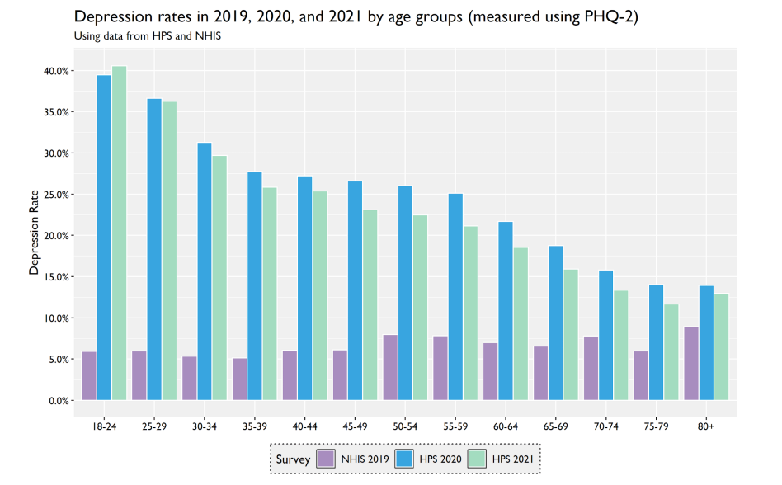
COVID-19
1. Cognitive and attention deficits (brain fog).
2. Anxiety and depression.
3. Psychosis.
4. Seizures
5. Suicidal behaviors
Notes:
Dobson, E., Graham, C., Hua, T., & Pinto, S. (n.d.). Brookings - Quality. Independence. Impact. https://www.brookings.edu/wp-content/uploads/2022/03/Despair-and-Resilience.pdf

Slide 19
Mental health and the family
Family members suffer when the veteran suffers.
They don’t know what is available.
They are scared to have a conversation about mental health with the veteran or service member.
It’s just to hard, so why fight it?
Notes:
When a service member leaves for a deployment, they take a snapshot in time of where their family is at.
Every time they think about their family, they return to the last time they remember seeing them.
But the family isn’t there anymore; they are moving on with life. The significant other is learning to pay the bills, mow the grass, get the kids lunch together. Learning how to be a single parent.
When the service member comes home, they want to go right back into the role they left. It’s not there anymore. That’s where the stress starts.
It is a hard conversation to have. It takes more strength to seek help than it does to ignore that problem

Slide 20
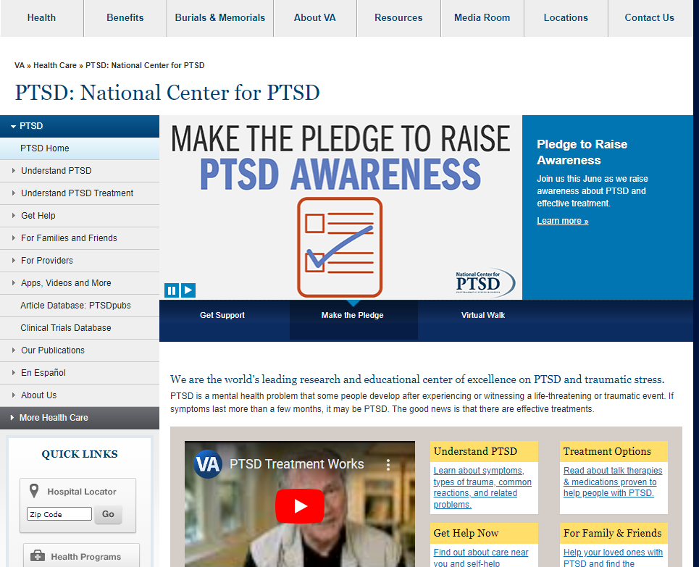
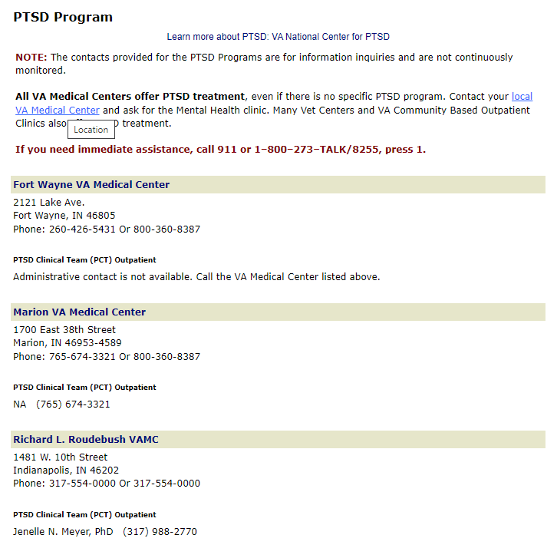
Resources
Federal
38 CFR Book C
U.S. Department of Veterans Affairs National Center for PTSD
988 (press 1)
VA’s PTSD Program Locator

Slide 21
National Resources
Mission 22: 6,026 Veterans and Families Served
$13,084,250 Funding into Programs
4,069 Volunteer Ambassadors.
Creative Arts for Vets (CAV): Art-based wellness
Art + Horses
Art + Farm
Yoga
Notes:
Mission 22: They provide extensive, personalized support and resources to help Veterans and their families thrive. Mission 22’s programs for Veterans and military spouses offer everything from biometric monitoring of stress, sleep, and activity levels; to meditation and coaching to exercise programs and a wellness supplement regimen to books and learning resources to help Veterans contextualize their experience.
Creative Arts for Vets (CAV) aims to support veterans and military-connected populations using arts-based approaches that promote connectedness and improve mental health and well-being. Creative Arts for Vets collaborates with veterans, military-connected populations, and community organizations to develop unique experiences that fit the needs and interests present in specific communities. These art-based wellness events are free, and we work anywhere in the state of Indiana and beyond.

Slide 22
Resources
Indiana
ICAN- Indiana Canine Assistant Network
SAMHSA
Indiana DAV
IN VFW
IN American Legion
Notes:
There is a difference between an emotional support animal and a service dog.
Substance Abuse Mental Health Services Administration
County VSO
Post Service Officer both VFW/AL

Slide 23
APPS

Slide 24
APPS

Slide 25
The Warrior's Prayer Long since, in sore distress, I heard one pray, 'Lord, who prevailest with resistless might, Ever from war and strife keep me away, My battles fight!' I know not if I play the Pharisee, And if my brother after all be right; But mine shall be the warriors plea to thee-- Strength for the fight. I do not ask that thou shalt front the fray, And drive the warring foeman from my sight; I only ask, O Lord, by night, by day, Strength for the fight! When foes upon me press, let me not quail Nor think to turn me into coward flight. I only ask, to make mine arms prevail, Strength for the fight! Still let mine eyes look ever on the foe, Still let mine armor case me strong and bright; And grant me, as I deal each righteous blow, Strength for the fight! And when, at eventide, the fray is done, My soul to Death's bedchamber do thou light, And give me, be the field or lost or won, Rest from the fight!
Paul Laurence Dunbar

Slide 26
Questions?

Slide 27
Summary
Over the last 45 minutes we discussed the evolution of mental health in the military. We looked at some major issues facing service members and veterans. Then finally we look at some resources and apps that could help service members or veterans facing a mental health crisis.

Slide 28
References
Dobson, E., Graham, C., Hua, T., & Pinto, S. (n.d.). Brookings - Quality. Independence. Impact. https://www.brookings.edu/wp-content/uploads/2022/03/Despair-and- Resilience.pdf
Horgan, J. (2010, April 23). Why soldiers get a kick out of killing. Scientific American Blog Network. https://blogs.scientificamerican.com/cross-check/
why-soldiers-get-a-kick-out-of-killing/
Mission Roll Call. (2023, March 29). The State of Veteran Suicide (2022). Mission Roll Call. https://www.missionrollcall.org/post/state-of-veteran-suicide
Tanielian, T., Jaycox, L. H., Schell, T. L., Marshall, G. N., Burnam, M. A., Eibner, C., Karney, B., Meredith, L. S., Ringel, J. S., & Vaiana, M. E. (2008, April 8). Invisible wounds: Mental health and cognitive care needs of America’s returning veterans. RAND Corporation. https://www.rand.org/pubs/research_briefs/RB9336.html
Veterans’ mental health issues. RAND Corporation. (n.d.). https://www.rand.org/health-care/projects/navigating-mental-health-care-for-veterans/mental-health- issues.html
2022 National Veterans Suicide Prevention Annual Report

Slide 29
Thank you
Ken Mattingly
kenneth.mattingly@centerstone.org
502-548-1995

